Slide 1

Project - Final Report
Visualization Of Google Play Store Dataset
Team Members (Name with Roll.No.):
D Shanmukha(22BDS019)
G Leeladitya(22BDS024)
Rajdeep Manik(22BDS048)
Vansh Lal Tolani(22BDS061)
Github Repo Link: https://github.com/shanmukha13/Google-play-store-app-visualization-project.git

Slide 2
Objective
To analyze and visualize the Google Play store app dataset in order to extract insights about trends, categories, and other key metrics from the app ecosystem.
To perform a detailed examination of app characteristics such as ratings, price, category, and installation numbers.
To create visualizations (e.g., bar charts , pie chart , line chart) to make the data more accessible and interpretable.

Slide 3
Dataset Description
Dataset source: https://www.kaggle.com/datasets/gauthamp10/google-playstore-apps
Dataset timeline (2010 - 2018)
Feature description : Number of features = 23 ,Details of 10k apps
Dataset format :1 CSV file
Data usage rights and licensing:
http://opendatacommons.org/licenses/dbcl/1.0/

Slide 4
Tools / Technologies used
Matplotlib (To create basic visualizations)
Pandas (For Data pre-processing)
Power Bi (To create Dashboard)

Slide 5
Results and Discussion
Key milestone and Tasks completed:
1. Data Analysis and Insights:
Performed exploratory data analysis (EDA) to identify trends, such as the distribution of ratings across different categories, the relationship between app price and rating, and the trend of installs across different app categories.
2. Visualizations Created:
Developed key visualizations like bar charts, pie charts, and line charts to illustrate relationships and trends in the data.
Used tools like Matplotlib,PoweerBI to create clear and insightful visual representations of the data.

Slide 6
Results and Discussion
Challenges Faced and Solutions Implemented
1.Data Pre-processing:
While removing the rows with null ratings we implemented mean imputation. Later we removed the rows entirely from dataset.
2. Visualization Complexity
Challenge: Creating visualizations that were both informative and easy to understand for an audience with varying technical backgrounds.
Solution : Focused on simple, intuitive visualizations like bar charts and line charts, and avoided overly complex visualizations that might confuse the audience.

Slide 7
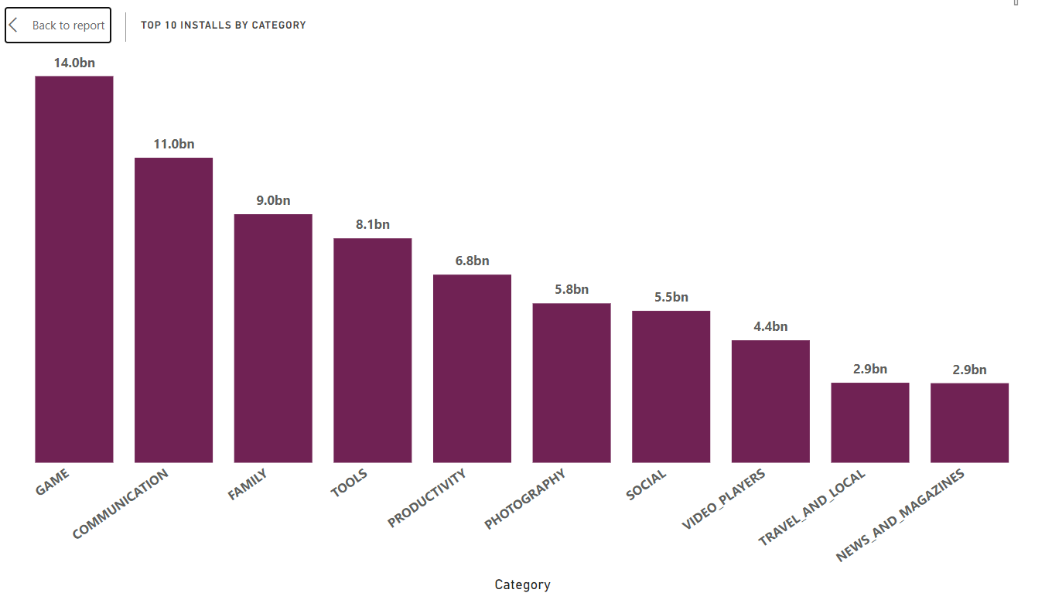

Slide 8
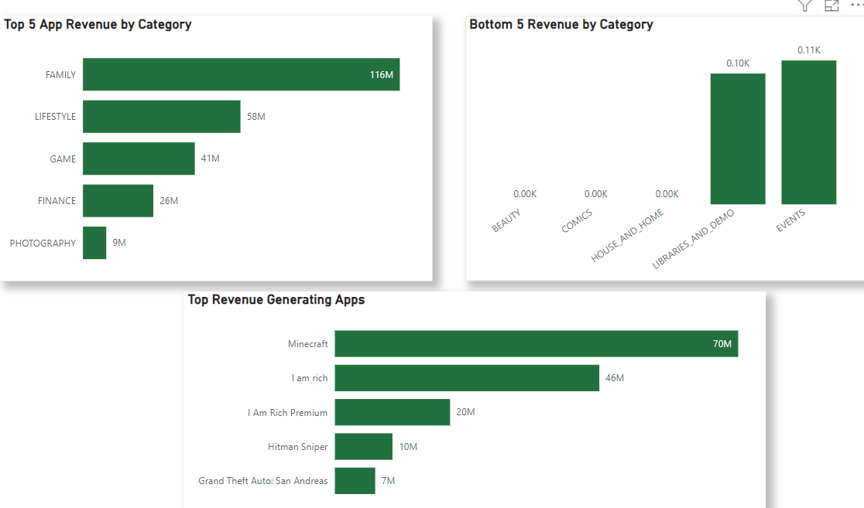

Slide 9
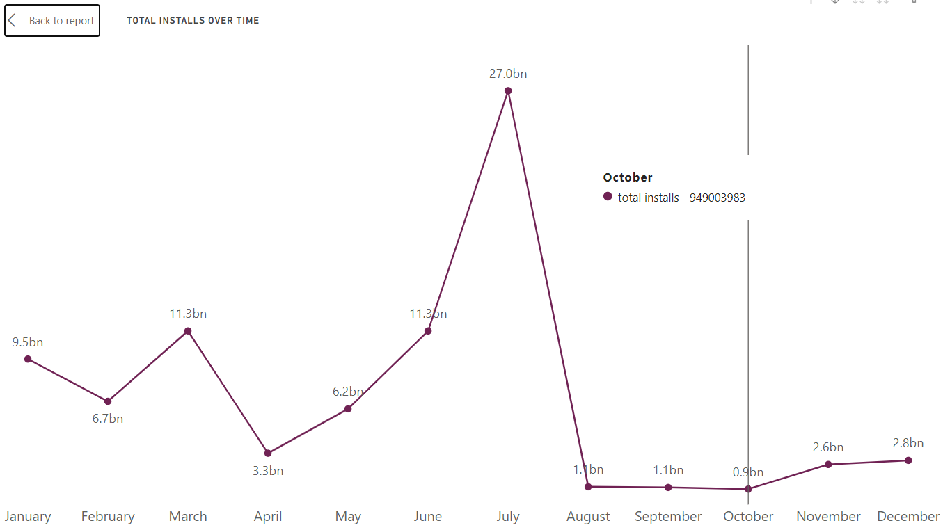

Slide 10
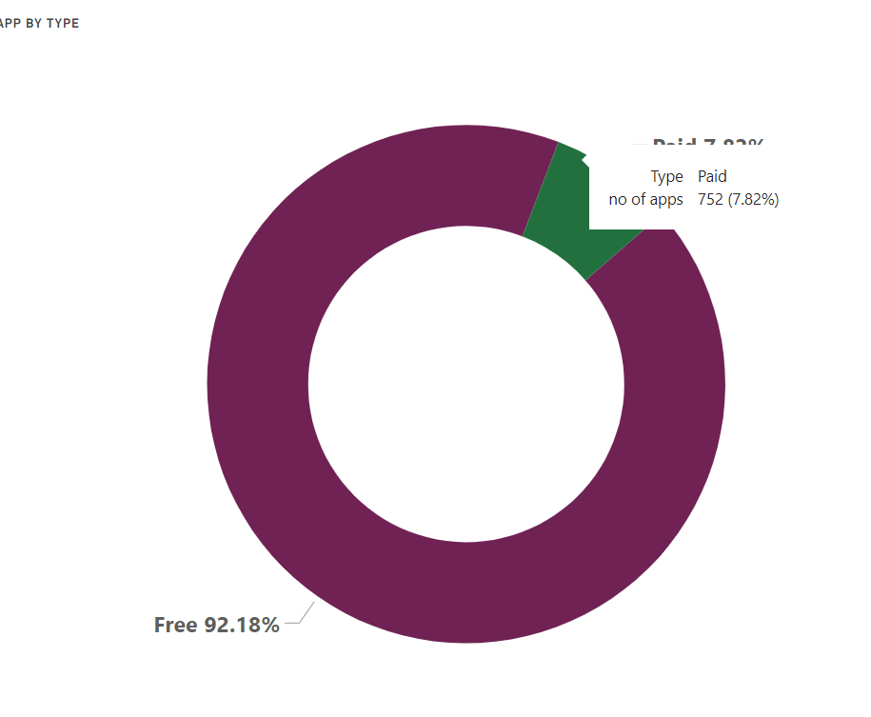

Slide 11
Scope for future
Expanding the Dataset:
Include data from other app platforms (e.g., Apple App Store) for cross-platform comparisons.
2. Improved Visualization Techniques:
Use more advanced visualization techniques, such as heatmaps or network graphs, to represent relationships between categories, apps, and ratings.
3. Real-time Data Integration:
Implement real-time data scraping or API calls to keep the dataset updated with the latest information from the Playstore, ensuring ongoing relevance and accuracy of the analysis.

Slide 12
Conclusion / References
Summary of the Project's Outcome:
This project involved analyzing and visualizing the Google Playstore app dataset to uncover key insights regarding app categories, ratings, installs, and pricing strategies.
Through various visualizations and data analyses, we were able to identify significant trends such as the relationship between app ratings and installs, the popularity of free apps, and the distribution of ratings across different categories.

Slide 13
Conclusion / References
2. Significance of the Project:
The insights derived from this project contribute to a better understanding of the dynamics of the mobile app market, particularly on the Google Play store platform.
By visualizing these trends, stakeholders (e.g., developers, marketers, investors) can make more informed decisions based on data-driven insights.

Slide 14
Contribution
Shanmukha –Made Power BI DashBoard
Leeladitya - Made Power BI DashBoard
Rajdeep –Suggested the figures
Vansh –Initial coding to get basic understanding about visualizations

Slide 15
Thank You !!!

